Slide 1
Welcome
to the
2024 Comfort in Care™
Ceremony
Proudly supported by
Gary Rowe Memorial Comfort in Care Fund
and donors

Slide 2
Mr. Omar Iqbal,
Senior Analyst, Affinity Partnerships, belairdirect.
Mr. Ron Johnson, Chief Operating Officer, Eastern Urban Zone VP, Innovation & Research
NL Health Services
Guest Speakers
Mr. Paul Snow, President and CEO, Health Care Foundation
Dr. Christopher Earle, MD FRCPC, Consultation-Liaison Psychiatrist Comfort in Care™ Grant Recipient
Proudly supported by
Gary Rowe Memorial Comfort in Care Fund
and donors

Slide 3
Omar Iqbal
Senior Analyst, Affinity Partnerships
belairdirect

Slide 4
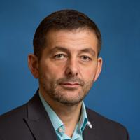
Ron Johnson
Chief Operating Officer, Eastern Urban Zone VP, Innovation & Research
NL Health Services

Slide 5
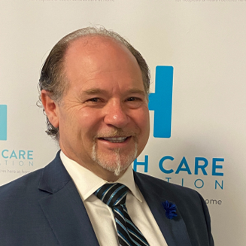
Paul Snow
President and CEO,
Health Care Foundation

Slide 6
Thank You!
Gary Rowe Memorial Comfort in Care fund
Community of donors

Slide 7
Dr. Christopher Earle Consultation–Liaison Psychiatrist,
Comfort in Care™ Grant Recipient

Slide 8
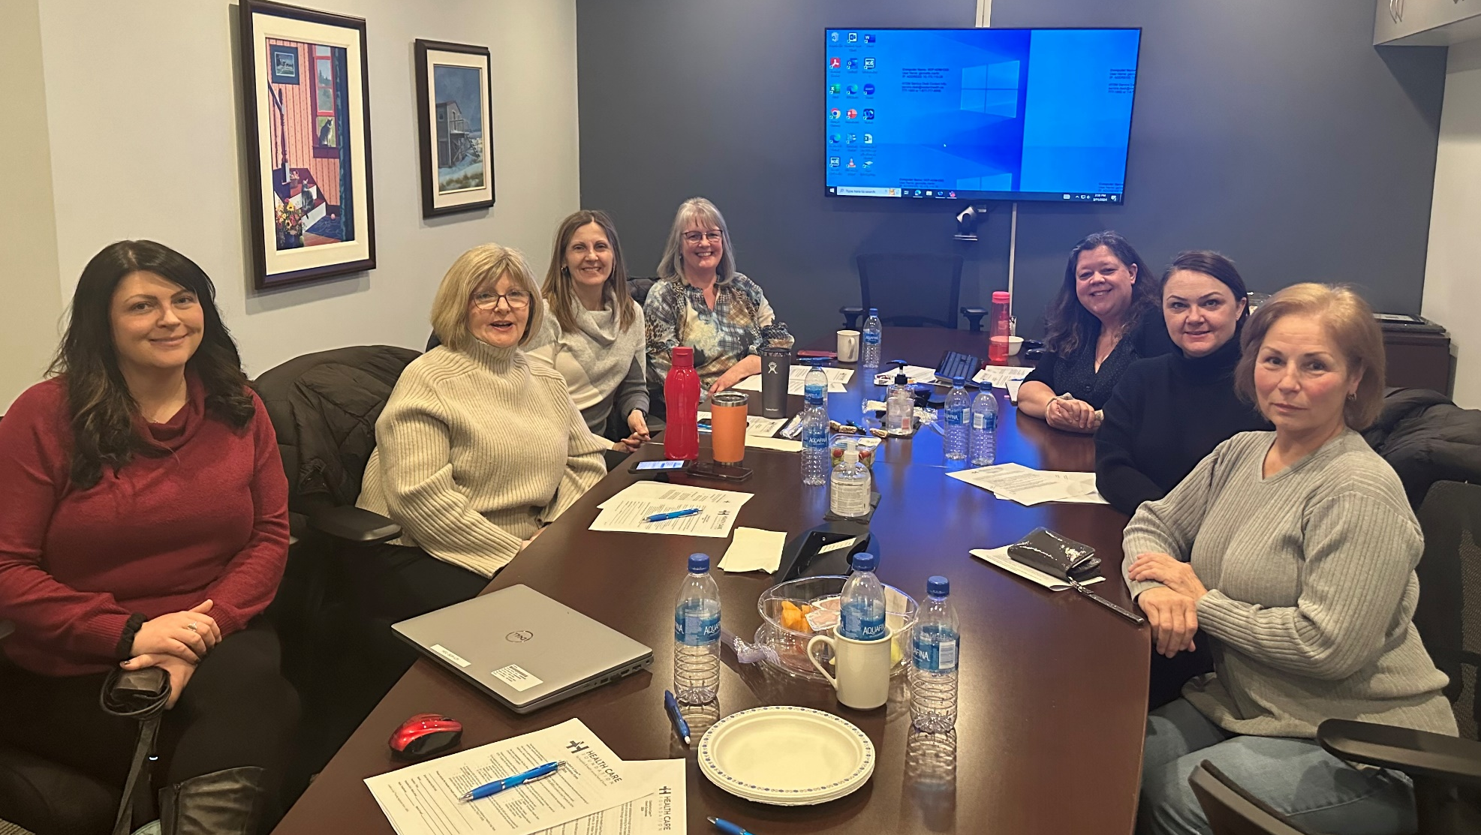
Thank You
to the
Comfort in Care™
Selections Committee
Proudly supported by
Gary Rowe Memorial Comfort in Care Fund
and donors

Slide 9
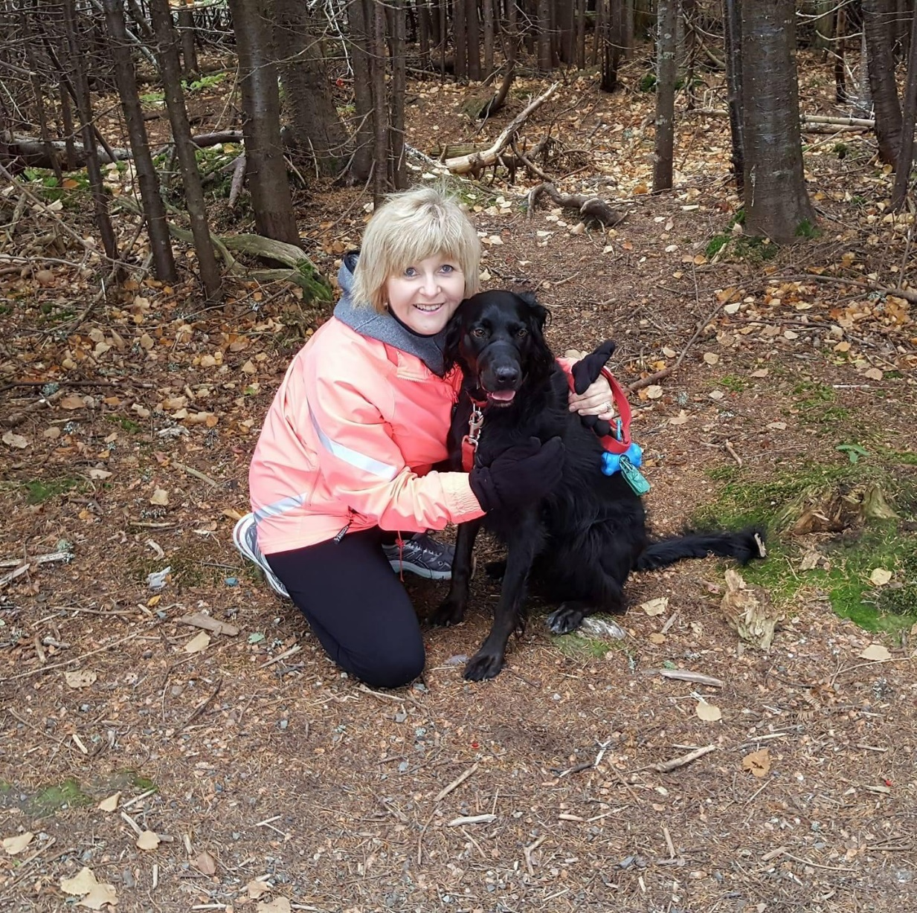
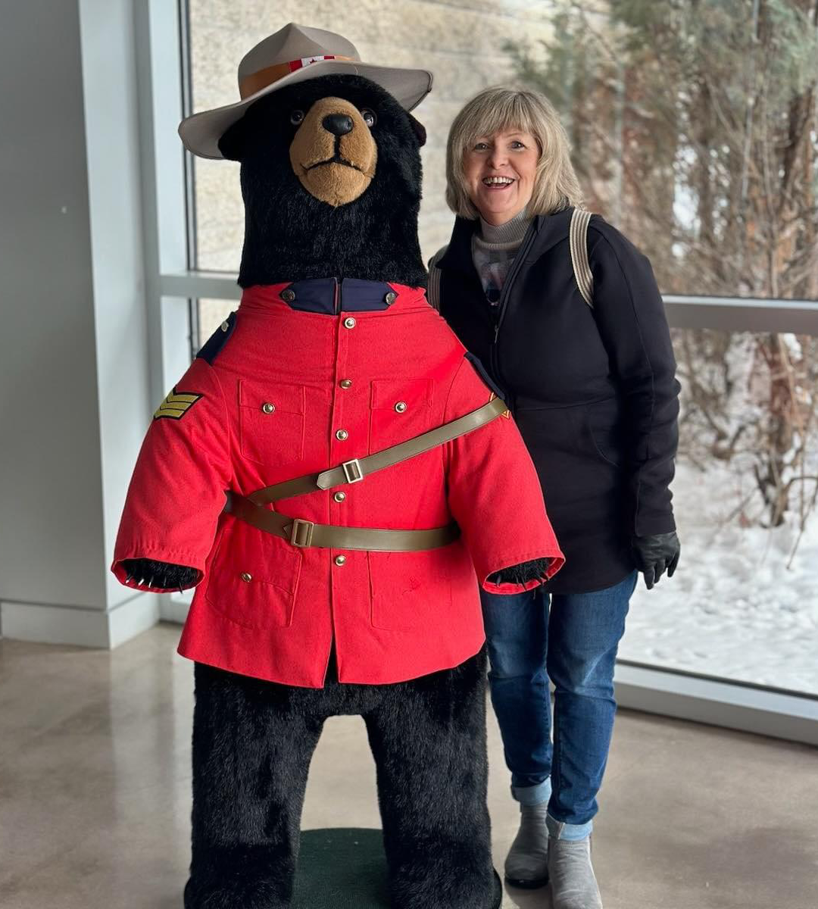
Thank You
Jackie!
Proudly supported by
Gary Rowe Memorial Comfort in Care Fund
and donors

Slide 10
Mr. Omar Iqbal, Senior Analyst, Affinity Partnerships
belairdirect
2024 Comfort in Care
Recipients
Proudly supported by
Gary Rowe Memorial Comfort in Care Fund
and donors

Slide 11
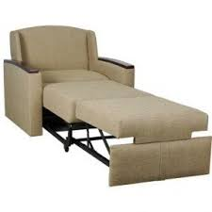
5 North B
Sleeper Chair
Aurette Power
Proudly supported by
Gary Rowe Memorial Comfort in Care Fund
and donors

Slide 12
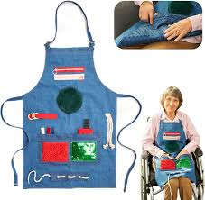
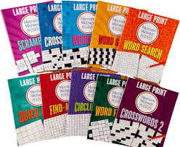
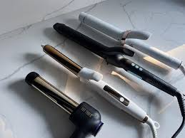
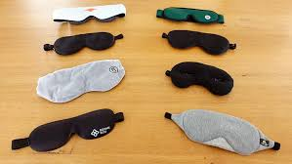
4 North A, 4 South A and 4 South B
Senior Friendly Cart
Catherine Babstock
Proudly supported by
Gary Rowe Memorial Comfort in Care Fund
and donors

Slide 13
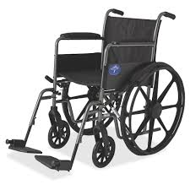
4 South B
Wheelchair
Dayle Prowse
Proudly supported by
Gary Rowe Memorial Comfort in Care Fund
and donors

Slide 14
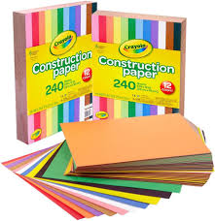
Consultation – Liaison Psychiatry Psychiatrist
Mental health workbooks and “Coping Kits”
Dr. Christopher Earle
Proudly supported by
Gary Rowe Memorial Comfort in Care Fund
and donors

Slide 15
Hyperbaric Medicine
Apple T.V.
Erin Penton
Proudly supported by
Gary Rowe Memorial Comfort in Care Fund
and donors

Slide 16
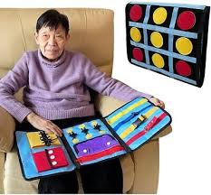
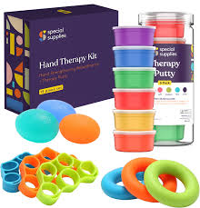
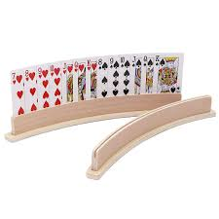
5 South B
Communication Board, Recovery Books, and Card Holders
Jade Regular
Proudly supported by
Gary Rowe Memorial Comfort in Care Fund
and donors

Slide 17
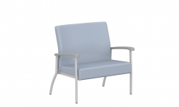
Audiology
Bariatric Chair
Jane Bowering
Proudly supported by
Gary Rowe Memorial Comfort in Care Fund
and donors

Slide 18
5 South B
Sleeper Chair
Julie Curtis
Proudly supported by
Gary Rowe Memorial Comfort in Care Fund
and donors

Slide 19
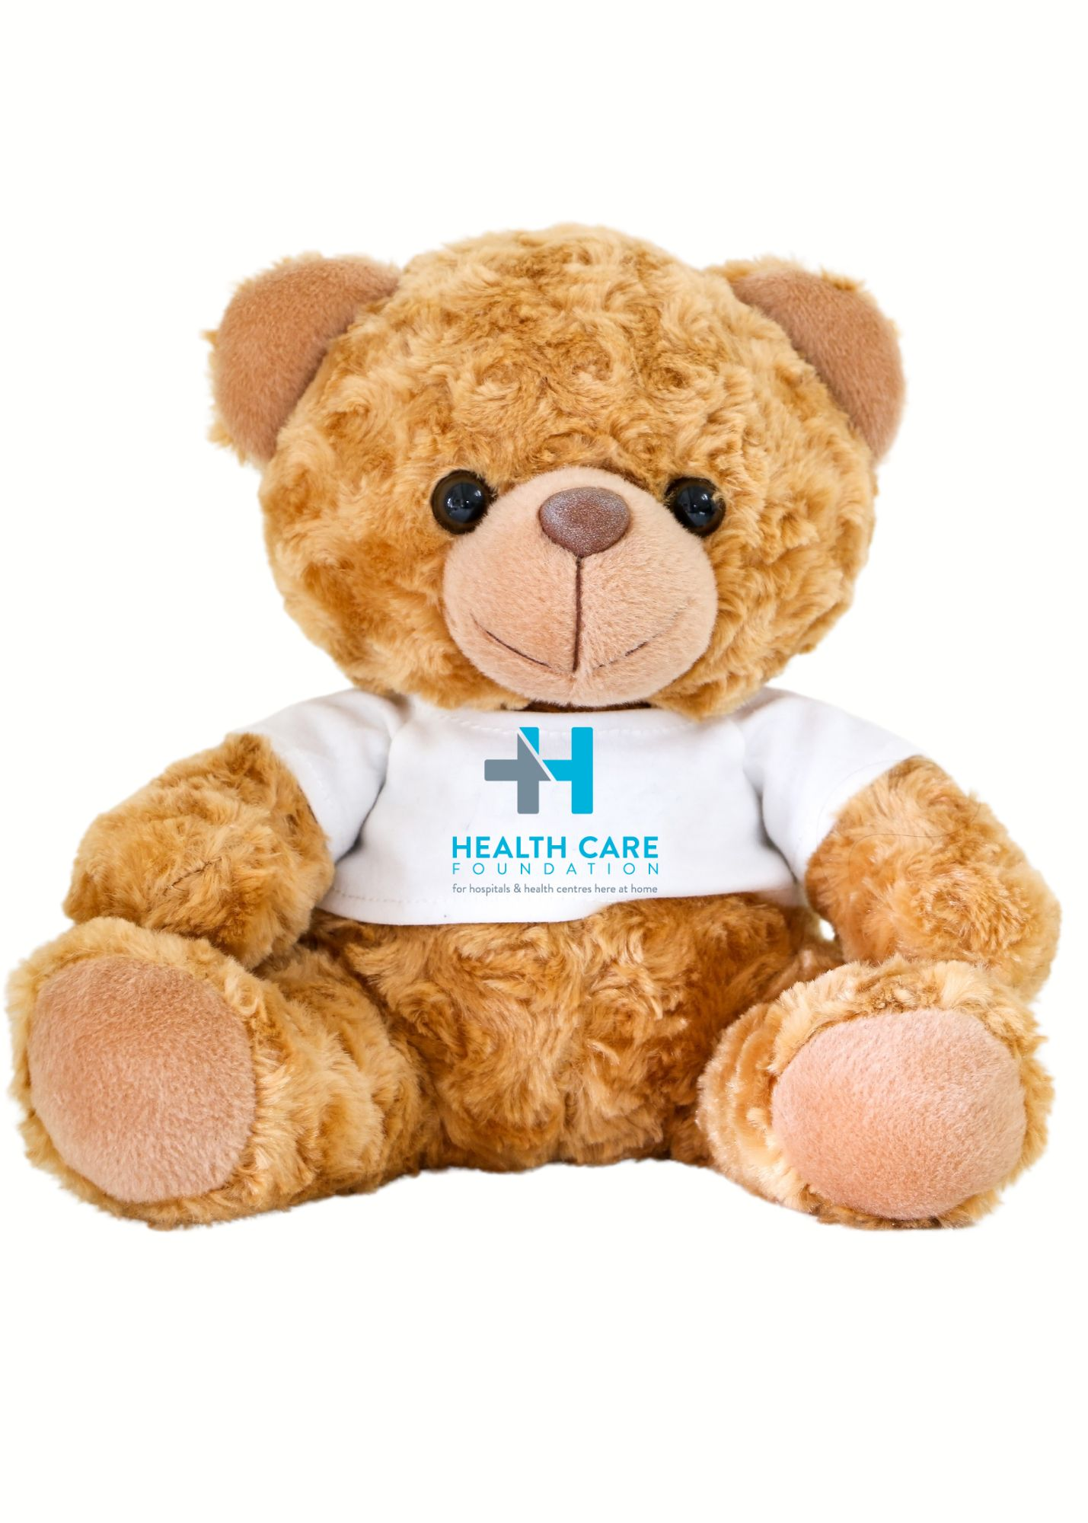
Paramedicine
Comfort Bears
Kayla Quinlan
Proudly supported by
Gary Rowe Memorial Comfort in Care Fund
and donors

Slide 20
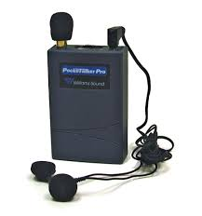
Neurology
Pocket Talker
Lillian McGrath
Proudly supported by
Gary Rowe Memorial Comfort in Care Fund
and donors

Slide 21
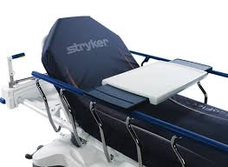
Emergency
Stryker Serving Trays
Loralie Cochrane
Proudly supported by
Gary Rowe Memorial Comfort in Care Fund
and donors

Slide 22
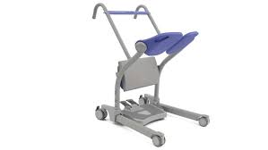
5 South B
Sara Stedy Sit to Stand Lift
Marlene Chaulk
Proudly supported by
Gary Rowe Memorial Comfort in Care Fund
and donors

Slide 23
Neurology - EEG
Pocket Talker
Melissa Burton
Proudly supported by
Gary Rowe Memorial Comfort in Care Fund
and donors

Slide 24
4 South A
Sleeper Chair
Nancy Williams
Proudly supported by
Gary Rowe Memorial Comfort in Care Fund
and donors

Slide 25
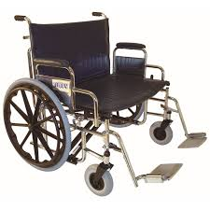
4 South B
Bariatric Wheelchair
Olivia Blake
Proudly supported by
Gary Rowe Memorial Comfort in Care Fund
and donors

Slide 26
4 North B
Wheelchair
Rebecca Winsor
Proudly supported by
Gary Rowe Memorial Comfort in Care Fund
and donors

Slide 27
Surgical Daycare
Wheelchair
Sarah David
Proudly supported by
Gary Rowe Memorial Comfort in Care Fund
and donors

Slide 28
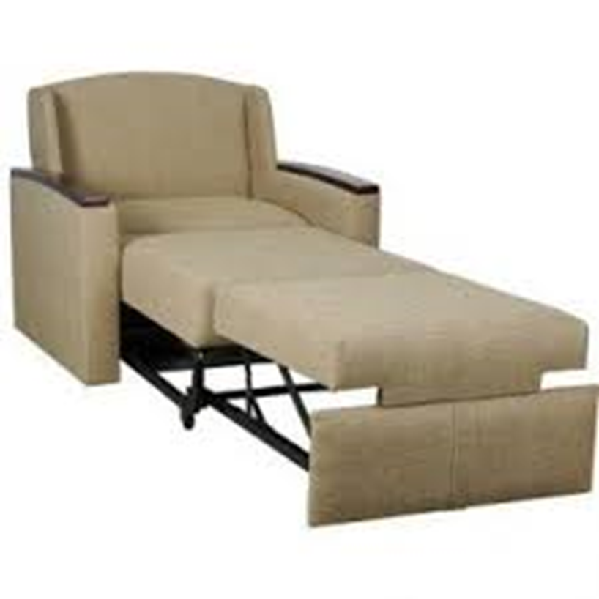
5 North A
Sleeper Chair
Sherry Noseworthy
Proudly supported by
Gary Rowe Memorial Comfort in Care Fund
and donors

Slide 29
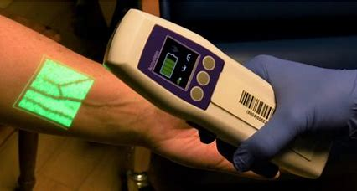
Bronchoscopy Unit
Vein Finder
Tanya Gladney
Proudly supported by
Gary Rowe Memorial Comfort in Care Fund
and donors

Slide 30
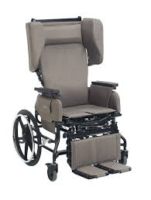
Emergency
Broda Chair
April Butt
Proudly supported by
Gary Rowe Memorial Comfort in Care Fund
and donors

Slide 31
6 West
Broda Chair
Dave Mercer
Proudly supported by
Gary Rowe Memorial Comfort in Care Fund
and donors

Slide 32
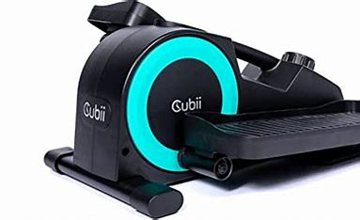
4 West
Bariatric Bedside Chair and Cubii Jr.
Elizabeth Elliott
Proudly supported by
Gary Rowe Memorial Comfort in Care Fund
and donors

Slide 33
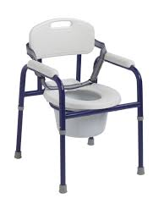
Endoscopy
Commode Chair and Vein Finder
Jeannie Harding
Proudly supported by
Gary Rowe Memorial Comfort in Care Fund
and donors

Slide 34
4 East
Sara Stedy Sit to Stand Lift
Jessica Hunt
Proudly supported by
Gary Rowe Memorial Comfort in Care Fund
and donors

Slide 35
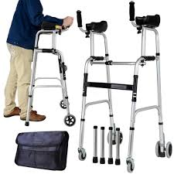
Surgery Program
4 Wheeled Walker with Forearm Support
Julia Windsor
Proudly supported by
Gary Rowe Memorial Comfort in Care Fund
and donors

Slide 36
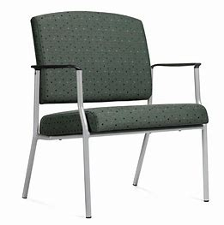
Pre-Admission Clinic
Bariatric Chairs
Krista Maloney
Proudly supported by
Gary Rowe Memorial Comfort in Care Fund
and donors

Slide 37
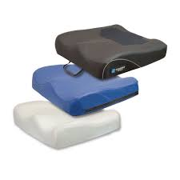
Occupational Therapy
Various Size Wheelchair Cushions and Bariatric Chair
Lois Chafe
Proudly supported by
Gary Rowe Memorial Comfort in Care Fund
and donors

Slide 38
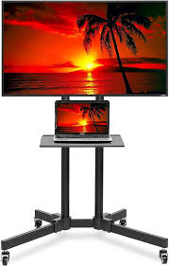
7 East
32” Fibre Tv with Mobile Cart and
DVD Player
Mackenzie Reid
Proudly supported by
Gary Rowe Memorial Comfort in Care Fund
and donors

Slide 39
Endoscopy
Vein Finder
Mary Pottle
Proudly supported by
Gary Rowe Memorial Comfort in Care Fund
and donors

Slide 40
7 West
Cubii Jr.
Sara Hollett
Proudly supported by
Gary Rowe Memorial Comfort in Care Fund
and donors

Slide 41
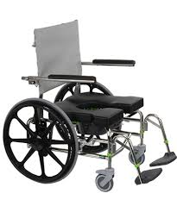
5 East
Commode with Amputee Attachments
Susan Dominix
Proudly supported by
Gary Rowe Memorial Comfort in Care Fund
and donors

Slide 42
6 East
Broda Chair
Tracy Sullivan
Proudly supported by
Gary Rowe Memorial Comfort in Care Fund
and donors

Slide 43
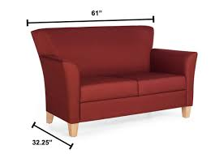
PIER Program
2 Seater Sofa
Amy McGrath and Tammy Manning
Proudly supported by
Gary Rowe Memorial Comfort in Care Fund
and donors

Slide 44
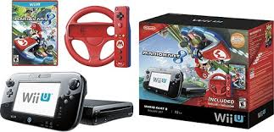
FACT Clinic – Waterford Hospital
Nintendo Wii Game Bundle
Angelique Myles
Proudly supported by
Gary Rowe Memorial Comfort in Care Fund
and donors

Slide 45
Short Stay Unit / PAU
Broda Chair
Kim Foley
Proudly supported by
Gary Rowe Memorial Comfort in Care Fund
and donors

Slide 46
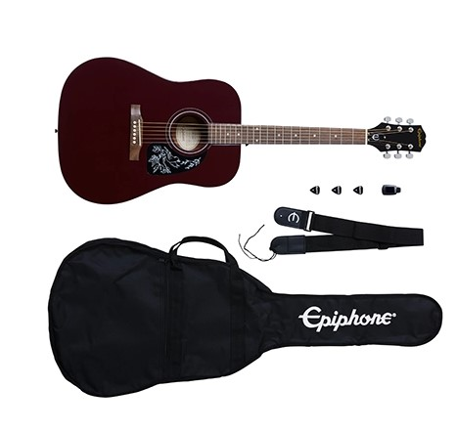
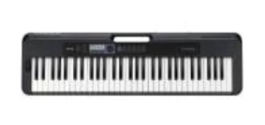
Geriatric PAU
Guitar Starter Pack and Portable Keyboard
Lisa Power
Proudly supported by
Gary Rowe Memorial Comfort in Care Fund
and donors

Slide 47
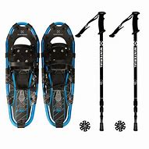
East 3 A
Snowshoes
Nancy Hodder
Proudly supported by
Gary Rowe Memorial Comfort in Care Fund
and donors

Slide 48
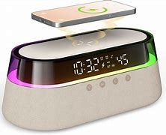
West 3 A
Clock Radios
Pam Finn
Proudly supported by
Gary Rowe Memorial Comfort in Care Fund
and donors

Slide 49
East 3 A
Tv and Stand with Wheels
Terri-Lynn Critch
Proudly supported by
Gary Rowe Memorial Comfort in Care Fund
and donors

Slide 50
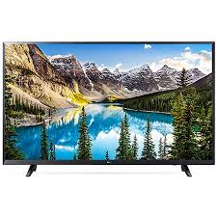
Geriatric PAU
44” Tv
Thomas Foley
Proudly supported by
Gary Rowe Memorial Comfort in Care Fund
and donors

Slide 51
FACT Clinic – LeMarchant Road
Nintendo Wii Game Pack
Angelique Myles
Proudly supported by
Gary Rowe Memorial Comfort in Care Fund
and donors

Slide 52
Mobile Crisis Unit
Bus Passes for Clients
Kathleen Coleman
Proudly supported by
Gary Rowe Memorial Comfort in Care Fund
and donors

Slide 53
Palliative Care Unit
Vein Finder
Kathy Cahill
Proudly supported by
Gary Rowe Memorial Comfort in Care Fund
and donors

Slide 54
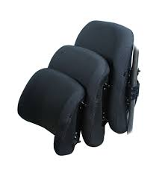
Occupational Therapy
Various Wheelchair Cushions and Backrests
Kimberly Coombes
Proudly supported by
Gary Rowe Memorial Comfort in Care Fund
and donors

Slide 55
Palliative Care Unit
Sleeper Chair
Terri-Lynn Stone
Proudly supported by
Gary Rowe Memorial Comfort in Care Fund
and donors

Slide 56
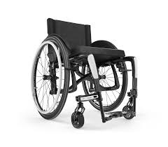
Occupational Therapy
Move Manual Heavy Duty Wheelchair and Cushion
Dawn Andrews
Proudly supported by
Gary Rowe Memorial Comfort in Care Fund
and donors

Slide 57
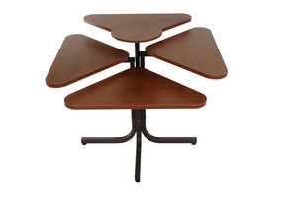
VP 2 South
Cloverleaf Table
Julie Sheppard
Proudly supported by
Gary Rowe Memorial Comfort in Care Fund
and donors

Slide 58
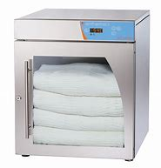
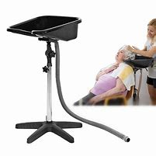
Dr. Walter Templeman HealthCare Centre
Blanket Warmer and Hair Washing Station
Jody O’Brien
Proudly supported by
Gary Rowe Memorial Comfort in Care Fund
and donors

Slide 59
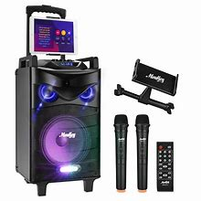
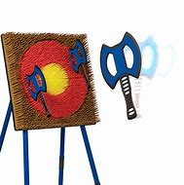
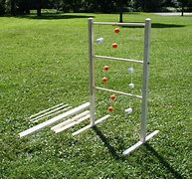
3 North East
Ladder Ball, Axe Throwing Game and Karaoke Speaker
Adesole Abiddunoje
Proudly supported by
Gary Rowe Memorial Comfort in Care Fund
and donors

Slide 60
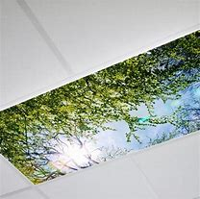
3 North West
Tree and Cloud Fluorescent Light Covers
Alicia Durnford
Proudly supported by
Gary Rowe Memorial Comfort in Care Fund
and donors

Slide 61
2 North West
Tree and Cloud Fluorescent Light Covers
Amanda Simms
Proudly supported by
Gary Rowe Memorial Comfort in Care Fund
and donors

Slide 62
4 North East
Hair Washing Station
Amelia Neil
Proudly supported by
Gary Rowe Memorial Comfort in Care Fund
and donors

Slide 63
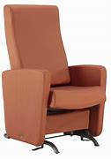
3 South West
Theraglide Safety Rocker
Angelia Verge
Proudly supported by
Gary Rowe Memorial Comfort in Care Fund
and donors

Slide 64
4 South East
Tree and Cloud Fluorescent Light Covers
Chantelle Johnson
Proudly supported by
Gary Rowe Memorial Comfort in Care Fund
and donors

Slide 65
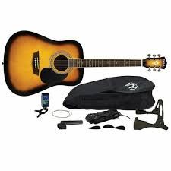
2 South West
Acoustic Guitar
Dylan White
Proudly supported by
Gary Rowe Memorial Comfort in Care Fund
and donors

Slide 66
3 South East
Hair Washing Station
Emily Whitten
Proudly supported by
Gary Rowe Memorial Comfort in Care Fund
and donors

Slide 67
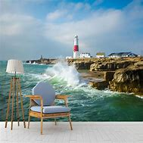
2 North East
Peel and Stick Wall Murals
Erica Priddle
Proudly supported by
Gary Rowe Memorial Comfort in Care Fund
and donors

Slide 68
3 South East
Sleeper Chair
Faith Drover
Proudly supported by
Gary Rowe Memorial Comfort in Care Fund
and donors

Slide 69
1 South West
Tree and Cloud Fluorescent Light Covers
Gillian Strong
Proudly supported by
Gary Rowe Memorial Comfort in Care Fund
and donors

Slide 70
1 South West
Pool Table, Rack and Cover
Gina Carter
Proudly supported by
Gary Rowe Memorial Comfort in Care Fund
and donors

Slide 71
3 North East
Wall Mounted Fireplace
Heather Best
Proudly supported by
Gary Rowe Memorial Comfort in Care Fund
and donors

Slide 72
1 North West
Hydroponic Garden and Starter Plants
Jeena Ki
Proudly supported by
Gary Rowe Memorial Comfort in Care Fund
and donors

Slide 73
1 South East
Peel and Stick Wall Murals
Jill Locke
Proudly supported by
Gary Rowe Memorial Comfort in Care Fund
and donors

Slide 74
1 North East
Snoezelen in a Bag
Kelsey Rose
Proudly supported by
Gary Rowe Memorial Comfort in Care Fund
and donors

Slide 75
4 North East
Terry Cloth Shower Bath Capes
Lindsay Lahey
Proudly supported by
Gary Rowe Memorial Comfort in Care Fund
and donors

Slide 76
4 South West
Smart Tv
Lori Russell
Proudly supported by
Gary Rowe Memorial Comfort in Care Fund
and donors

Slide 77
2 South West
Peel and Stick Wall Murals
Lynzie Mahoney
Proudly supported by
Gary Rowe Memorial Comfort in Care Fund
and donors

Slide 78
4 North West
Tree and Cloud Fluorescent Light Covers
Miriam Okyere-Kwarteng
Proudly supported by
Gary Rowe Memorial Comfort in Care Fund
and donors

Slide 79
2 North East
Tree and Cloud Fluorescent Light Covers
Nicole Pretty
Proudly supported by
Gary Rowe Memorial Comfort in Care Fund
and donors

Slide 80
2 South East
Tree and Cloud Fluorescent Light Covers
Pamela Philpott
Proudly supported by
Gary Rowe Memorial Comfort in Care Fund
and donors

Slide 81
4 South East
Peel and Stick Wall Murals
Patience Newhook
Proudly supported by
Gary Rowe Memorial Comfort in Care Fund
and donors

Slide 82
2 North West
Peel and Stick Wall Murals
Patti Lynn Harvey
Proudly supported by
Gary Rowe Memorial Comfort in Care Fund
and donors

Slide 83
1 South East
Tree and Cloud Fluorescent Light Covers
Suzanne Ridgley
Proudly supported by
Gary Rowe Memorial Comfort in Care Fund
and donors

Slide 84
4 North East
Tree and Cloud Fluorescent Light Covers
Tiffany O’Neill
Proudly supported by
Gary Rowe Memorial Comfort in Care Fund
and donors

Slide 85
3 South West
Bean Bag and Board Games
Tina Christopher
Proudly supported by
Gary Rowe Memorial Comfort in Care Fund
and donors

Slide 86
2 South East
Projector with Screen, Cart and Yard Pong
Tina Fitzpatrick
Proudly supported by
Gary Rowe Memorial Comfort in Care Fund
and donors

Slide 87
4 North West
Peel and Stick Wall Murals
Tom Neil
Proudly supported by
Gary Rowe Memorial Comfort in Care Fund
and donors

Slide 88
3 North West
Foldable Pool Table
Travis Fraize
Proudly supported by
Gary Rowe Memorial Comfort in Care Fund
and donors

Slide 89
3 South East
Exercise Equipment
Victoria Laite
Proudly supported by
Gary Rowe Memorial Comfort in Care Fund
and donors

Slide 90
Nuclear and Medical Imaging
Vein Lite LED+
Tammy Hudson
Proudly supported by
Gary Rowe Memorial Comfort in Care Fund
and donors

Slide 91
Kidney Care Centre – Home Dialysis
Electric Fireplace, Coffee Table and Artificial Plants
Ashley Boland
Proudly supported by
Gary Rowe Memorial Comfort in Care Fund
and donors

Slide 92
Hope Program – Major’s Path
Bariatric Chairs
Amy Martin
Proudly supported by
Gary Rowe Memorial Comfort in Care Fund
and donors

Slide 93
Hope Program – Major’s Path
Life without Ed Books, Grocery Cards and Bus Passes
Ashley Walsh
Proudly supported by
Gary Rowe Memorial Comfort in Care Fund
and donors

Slide 94
Mental Health & Addictions – Major’s Path
Weighted Lap Pads and Hoberman Spheres
Kelly Littlejohn
Proudly supported by
Gary Rowe Memorial Comfort in Care Fund
and donors

Slide 95
Community Care Centre
12 x 14 Gazebo
Erica Curtis
Proudly supported by
Gary Rowe Memorial Comfort in Care Fund
and donors

Slide 96
Traumatic Stress Services – Cordage Place
Bariatric Lounge Chair
Krista Hall
Proudly supported by
Gary Rowe Memorial Comfort in Care Fund
and donors

Slide 97
Community Mental Health – West Team
Cornhole Boards, Bean Bags and Score Keepers
Suzanne Coffey
Proudly supported by
Gary Rowe Memorial Comfort in Care Fund
and donors

Slide 98
Primary Care Team – East
Pocket Talker
Allison Stacey
Proudly supported by
Gary Rowe Memorial Comfort in Care Fund
and donors

Slide 99
Dialysis Unit - HSC
Pulse Oximeter
Chelsea Murphy
Proudly supported by
Gary Rowe Memorial Comfort in Care Fund
and donors

Slide 100
Thank You!
Proudly supported by
Gary Rowe Memorial Comfort in Care Fund
and donors

